Slide 1
Project Luther - S&P500 Stock Performance vs Economic and Various Index Indicators
Analysis by Andre Johnson

Slide 2
Overview
Developed program that will allow the selection of various economic and indices data scraped from various web sites to look at the correlations with S&P500 returns 6 months in the future
Data Sources used past 10 years data (120 rows of data):
Data scraped from Yale School of Management:
US One Year Index - Stock Market Confidence Index for Institutional and Individual
US Crash Confidence Index
US Buy-On-Dips Confidence Index
United States Valuation Index
Data scraped from the Federal Reserve Board of St Louis (FRED):
GDP (considered GDP Quarter over previous Quarter growth)
IC4WSA - 4-Week Moving Average of Initial Claims
NPPTTL - Total Nonfarm Private Payroll Employment
FRBKCLMCIM - KC Fed Labor Market Conditions Index, Momentum Indicator
CNP16OV - Civilian Noninstitutional Population
Data downloaded from the Yahoo Finance:
S&P500
Conclusion: Predicting the stock market is not easy!

Slide 3
Correlation

Slide 4
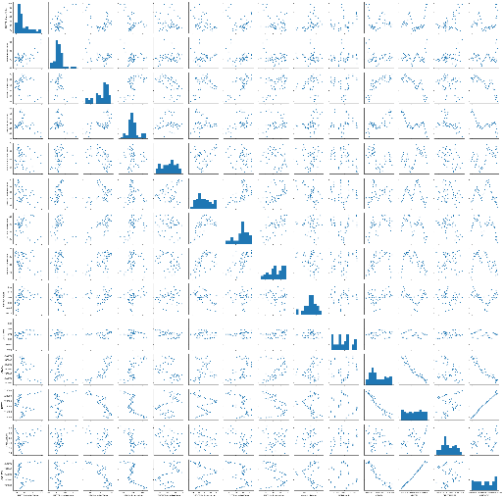
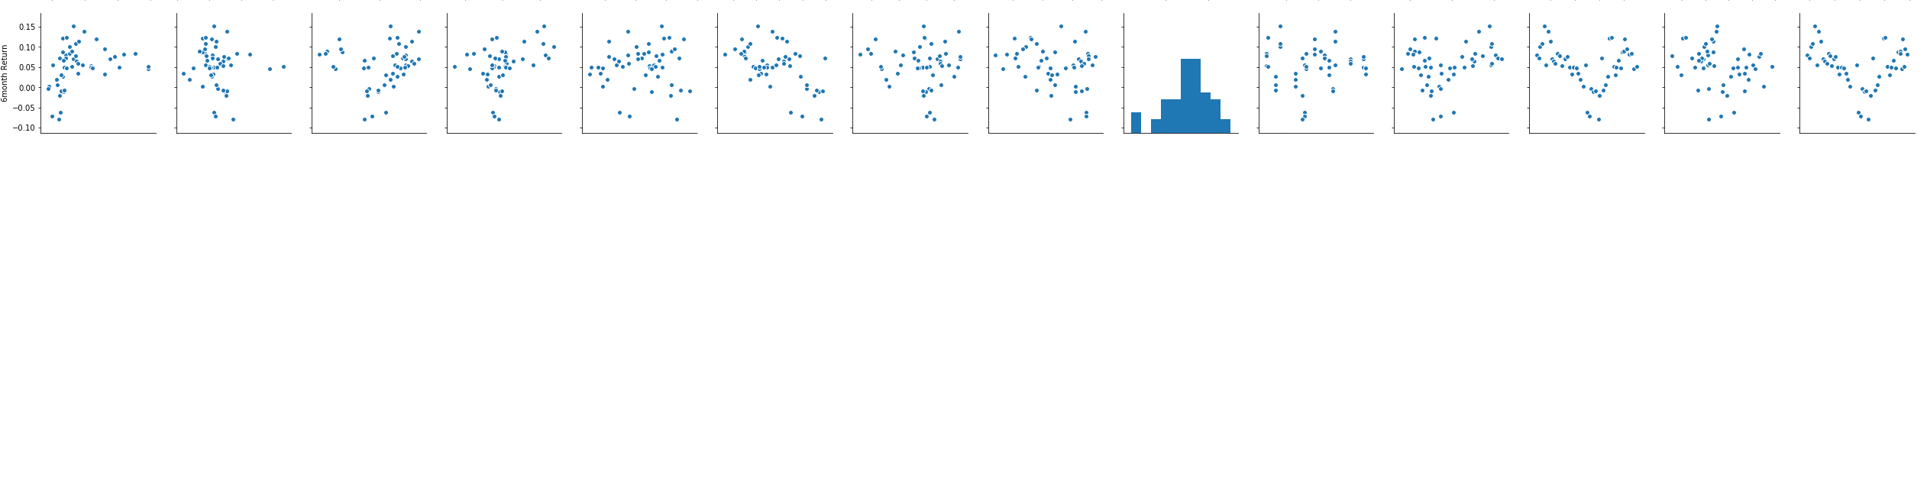
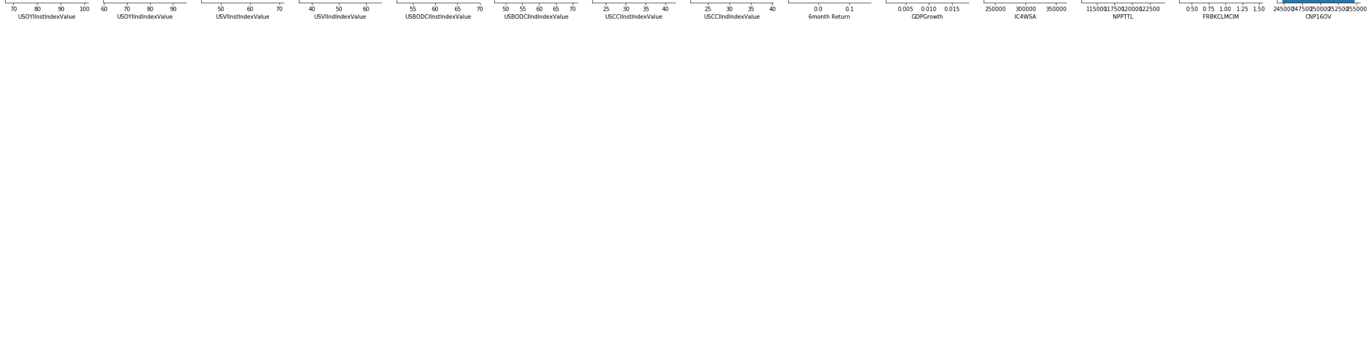
Correlation – Pairs Plot

Slide 5
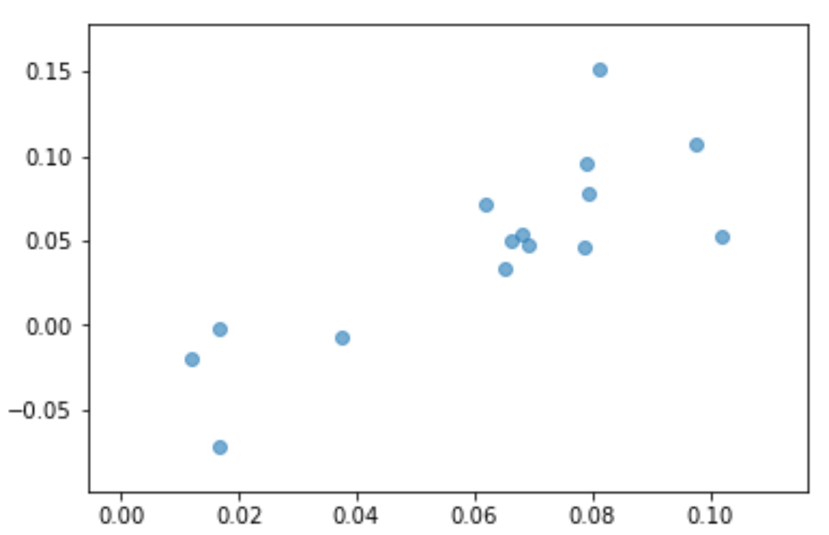
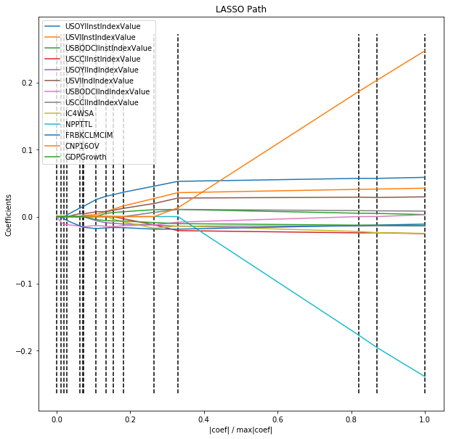
Linear Regression and LassoCV Models 1
Coefficients:
ScatterPlot:
Linear Regression
No Standardization of Variable values
R-squared: .4033
RSME = .0412
LassoCV
Standardized variable values
R-squared: .4829
RSME = .0383
Lasso Path:
Coefficients:

Slide 6
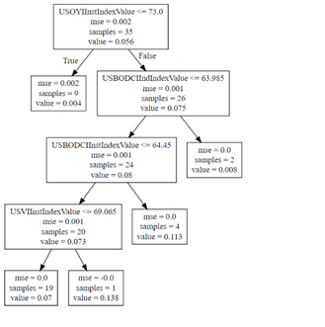
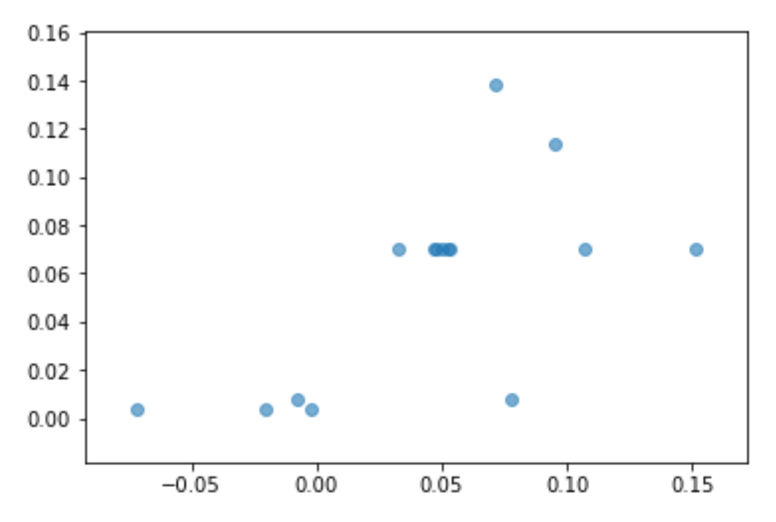
DecisionTree Model
Decision Tree
R-squared = .35
RSME = .0428
Decision Tree Visualization:
ScatterPlot:

Slide 7
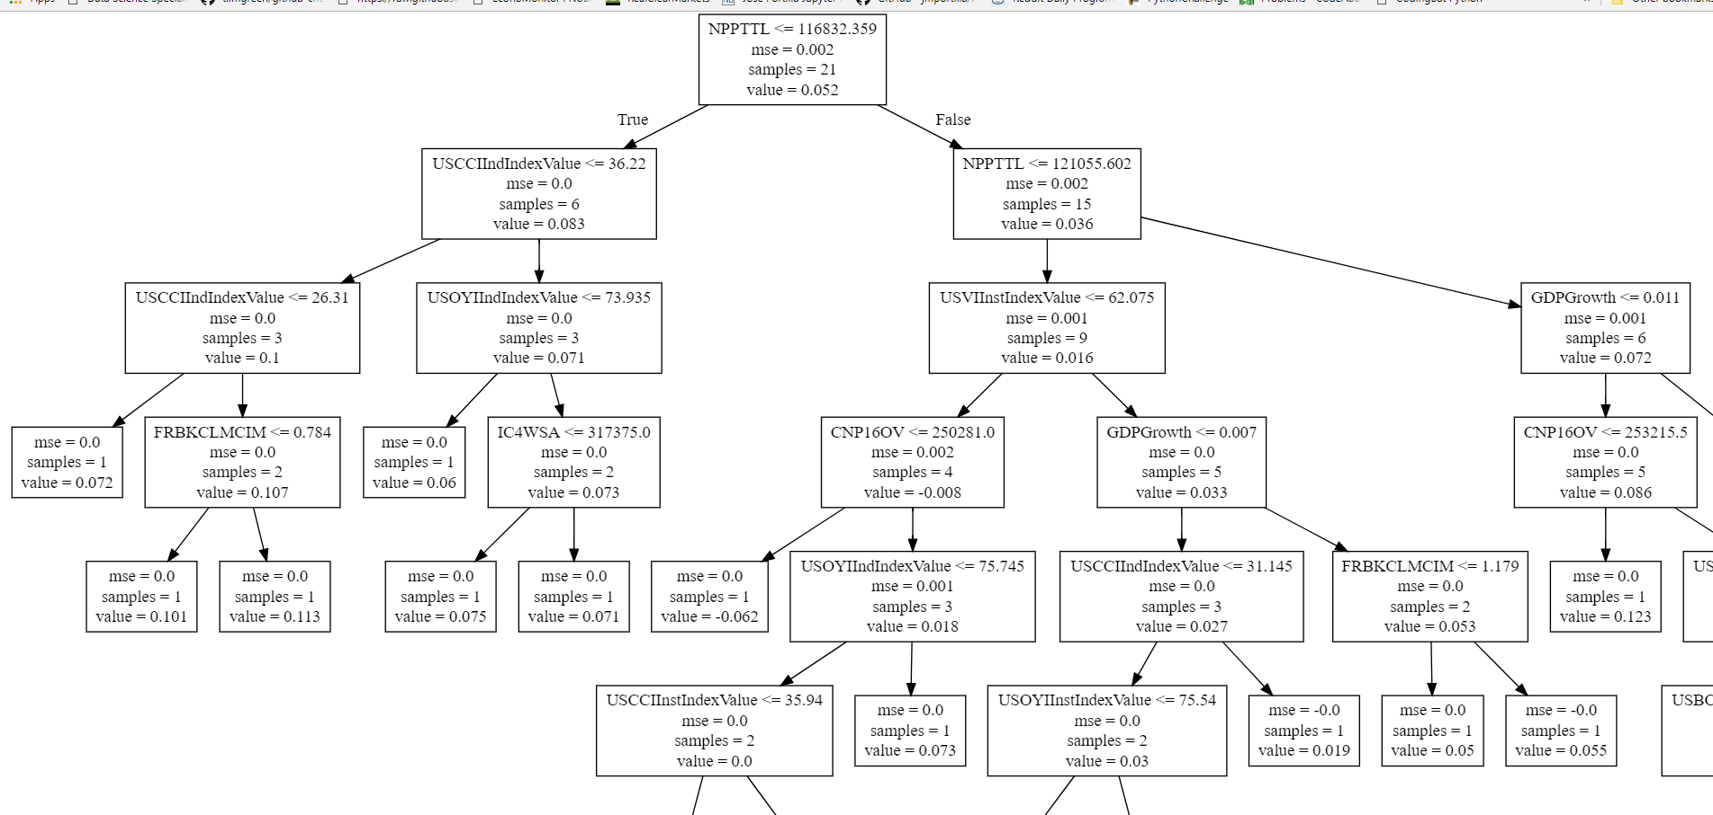
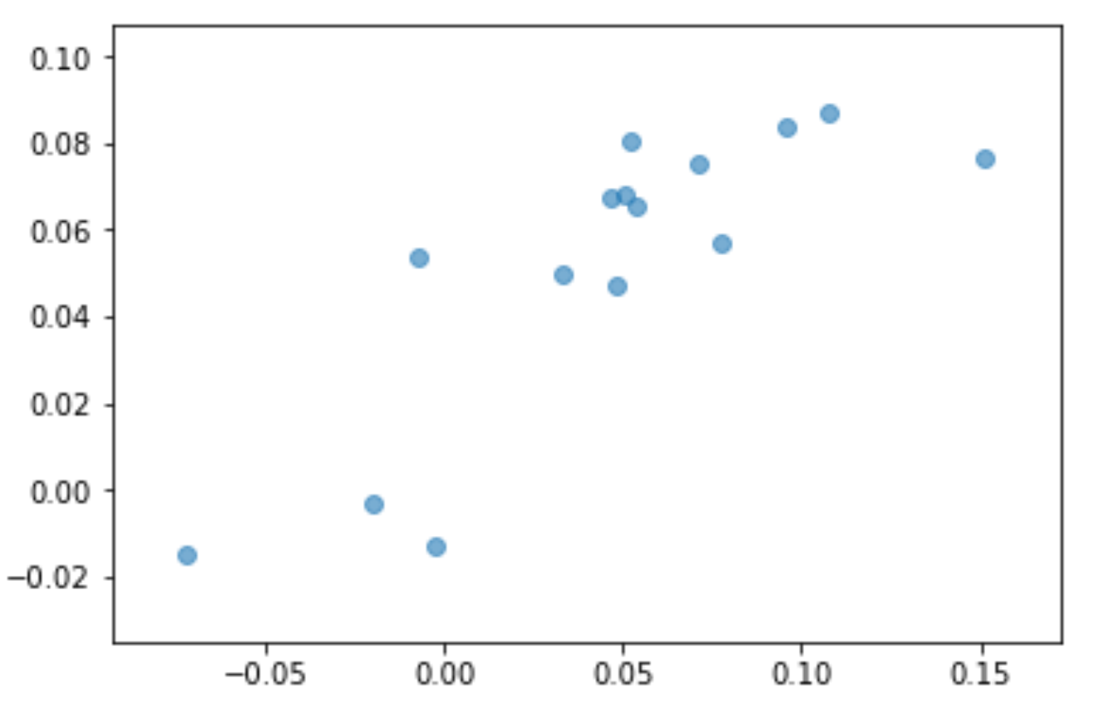
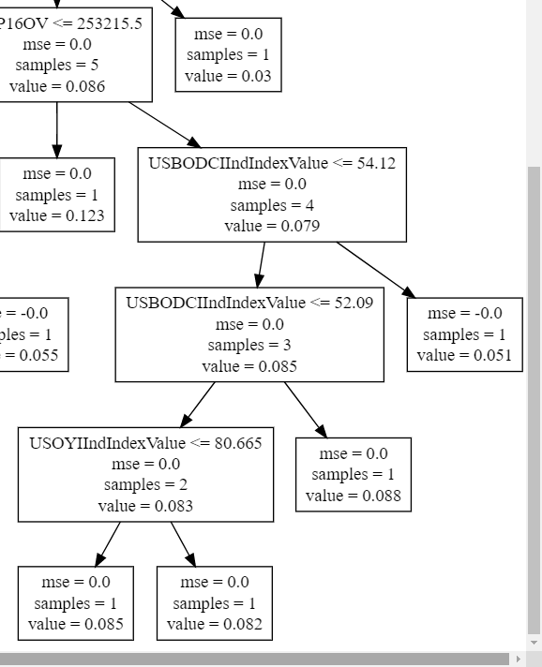
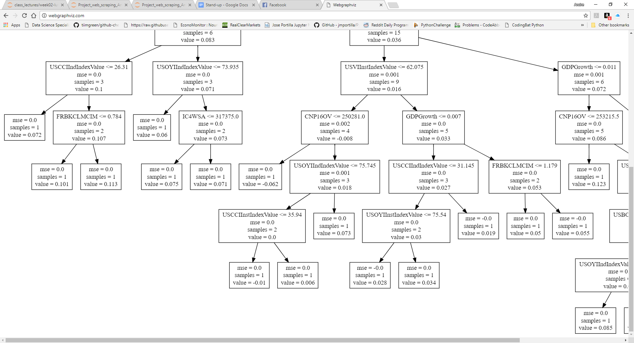
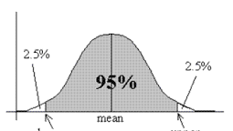
RandomForest Model
Random Forest Score*
R-squared = .6639
RSME = .0745(7.45%)
Single Decision Tree Visualization:
ScatterPlot:
+/- .149 (14.9%)
*(n_estimators = 500, min_samples_leaf=1, n_jobs=-1, max_features=4)

Slide 8
Gradient Boosting Regressor Models
Gradient Boosting Regressor 2 using GridSearch**
R-squared = .7879
RSME = .0633(6.33%)
+/- .126 (12.6%)
**parameters = {'max_depth':[4,5,6],
'learning_rate':np.arange(.01,.1,.01),
'n_estimators':[100, 250, 500]}
steps = { ('features', preprocessing.PolynomialFeatures(degree=2)),
('feature_selection', feature_selection.SelectFromModel(linear_model.Lasso(alpha = .2))),
('model',ensemble.GradientBoostingRegressor())] }

Slide 9
Next Steps
More high quality data – some require paid subscription (Bloomberg, Reuters)
More than 10 years of data (120 data points)
Stock market movement is subject to “black swan” events (multi standard deviation events)
Model against different Stock Market Indices and time frames,
eg. Dow Jones, Nasdaq for 3 month, 1 year forward, etc.
Notes:
Robust macroeconomic and stock predicting algorithms exist in the market and take into consideration a much larger set of data much of which is only available through paid platforms (Reuters, Bloomberg, etc.) – getting access to this data would likely improve the model significantly
Only 10 years of data (120 data points) was used due to availability – analysis against longer than 10 years would be helpful while looking at weighting more recent data higher to capture more recent trends, trading strategies, technology impacts, etc.
Stock market movement is subject to “black swan” events (multi standard deviation events) such as occurred in 2007 that can be hard to capture in any model when modelling extended time frames
Model against different Stock Market Indices and time frames, eg. Dow Jones, Nasdaq for 3 month, 1 year forward, etc.

Slide 10
Conclusion
Fairly good results and definitive correlations
Gradient Boosting GridSearch model performed the best with R-squared of .7879 but with a RMSE = .0633(6.33%)
And hence “NOONE SHOULD TRADE BASED ON THESE MODELS”
Notes:
Fairly good results and definitive correlations of indices and economic factors to S&P500 returns despite the limited data set
Gradient Boosting GridSearch model performed the best with R-squared of .7879 but with a RMSE = .0633(6.33%) that is a pretty wide window
And hence “NOONE SHOULD TRADE BASED ON THESE MODELS” especially for longer (but short time) horizons

Slide 11
Appendices

Slide 12
RandomForest GridSearch Model
RandomForest Regressor using GridSearch (n_estimators=500, max_depth=5,6)
steps = [
('features', preprocessing.PolynomialFeatures(degree=2)),
('model',ensemble.RandomForestRegressor())]
R-squared = .5103
RSME = .0373(3.73%)
RandomForest Regressor using GridSearch (n_estimators=100, 250,500, max_depth=4,5,6)
steps = [
('model',ensemble.RandomForestRegressor())]
R-squared = .5975
RSME = .0339(3.39%)

